Slide 1


Simulation
IE 406/408
Dr. Xueping Li
University of Tennessee, Knoxville

Slide 2
Customization and Deployment

Slide 3
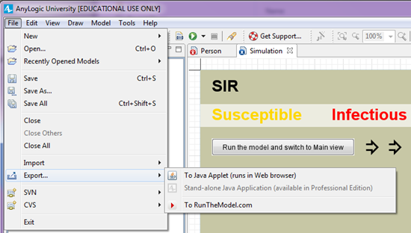
Export … //software independent!
Java Applet runs in a web browser
Stand-alone (pro license needed)
PC/Mac/Linux …
Online

Slide 4
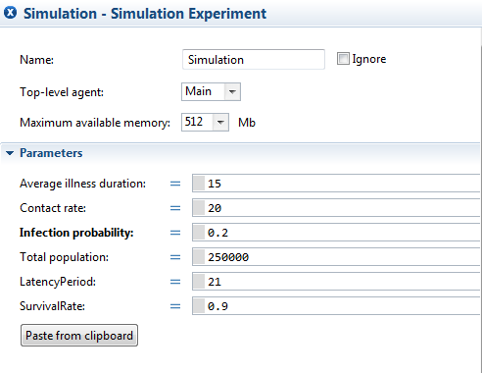
Running options

Slide 5
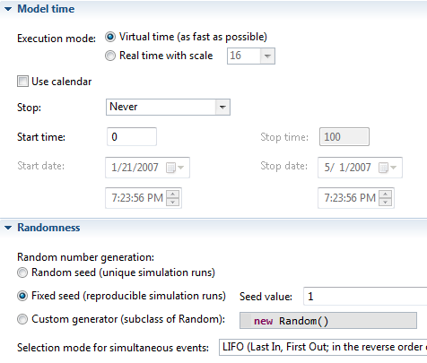
Model Time

Slide 6
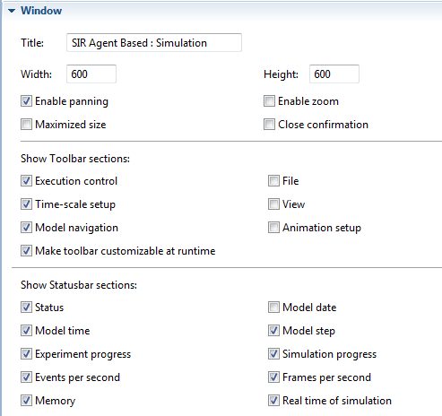
Window

Slide 7
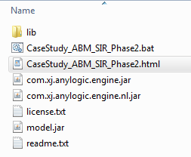
Exported folder

Slide 8
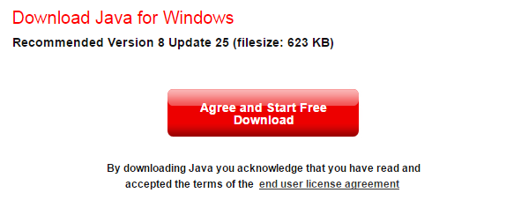
*Java updates
Make sure your Java is updated …

Slide 9
Export “Parameters Variation” & “Optimization”
Similar to exporting “Simulation” runs, you can export “Parameters Variation” & “Optimization”

Slide 10
Controls?

